Slide 1

Business Monitoring Dashboard
Business analysis
with Excel
16 feb 2021

Slide 2

Problem Statement And Source Of Data
Analyse state vice revenue generated by each item.
How much % item vice business done by each mode.
Analyse revenue generated by item across the years.
Source of data :-
I got dataset from the website named as excelfind.com and this data contain 5780 Rows and 10 columns.
Video link:- https://youtu.be/tb-FMbHfbSw
Description :-
The analysis is for a company who do business In three modes like through their website ,E-commerce platform and from shops etc. So I have analysed that which mode is contributing more in a business . The business is of five mobile accessories like mobile cover ,power bank ,charger ,earphone and screen guard etc.
Problem Statements :-
Analyse all the three years of sales from 2017 to 2019.
Show intensity of sales on map.
How much percent on-time delivery happened.
How much percent the product returned.
Analyse revenue generated by each business modes.
How much percent unit was sold according to states.
How many did orders place in each state.
Analyse costumers satisfaction level from feedbacks.

Slide 3

Outcomes From Analysis
Outcomes :-
Company able to understand the trend in business .
Helps in finding which business mode is contributing more.
Helps company in decision making that in which business mode should invest more.
To know about customers view on product.
It provides state vice products demand.
The analysis tells about most likely product out of all products.
Helps in monitoring business from all aspects.

Slide 4
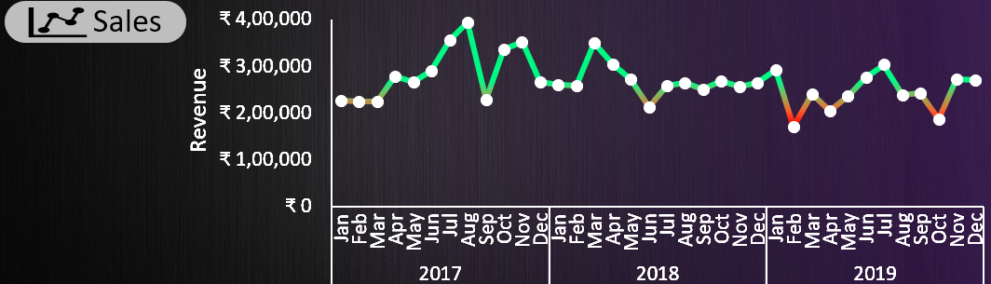
Line chart to show trend in business

Slide 5
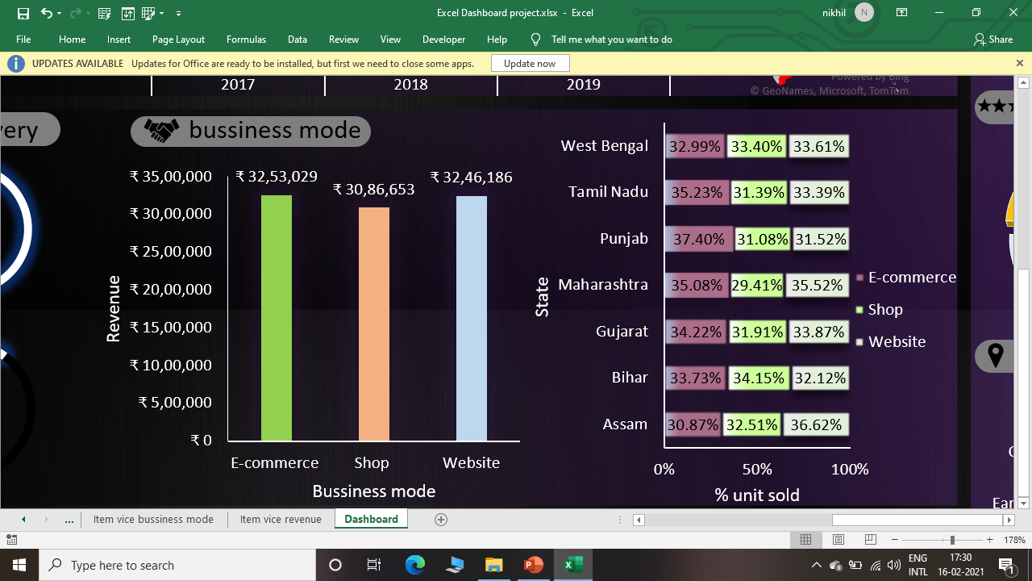
Column and bar chart for business mode vice analysis

Slide 6
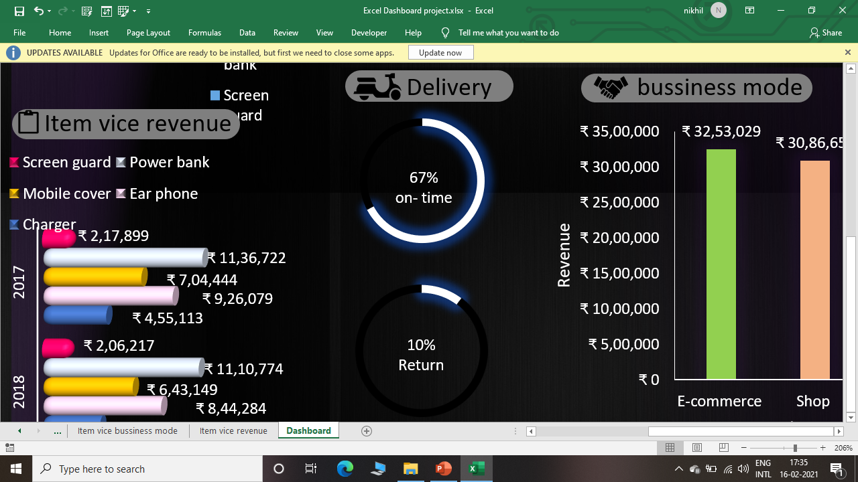
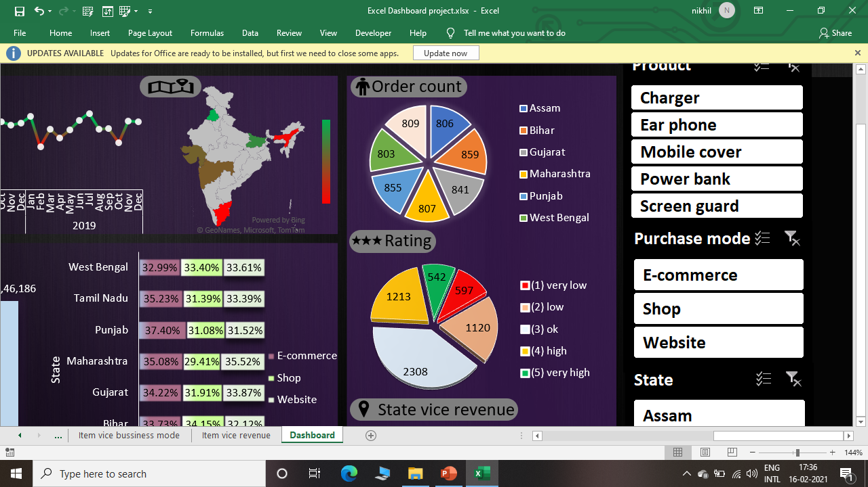
Donut chart for delivery analysis and pie chart for orders and customers ratings

Slide 7
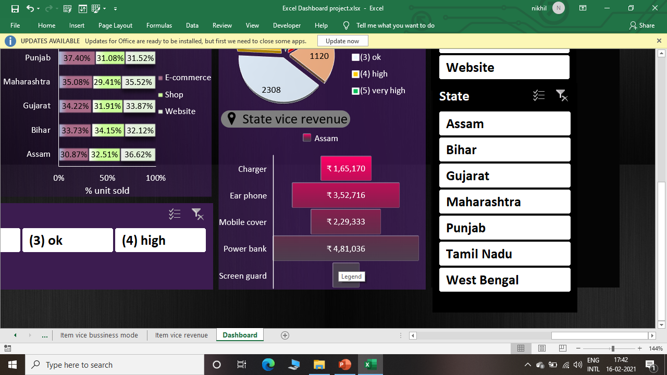
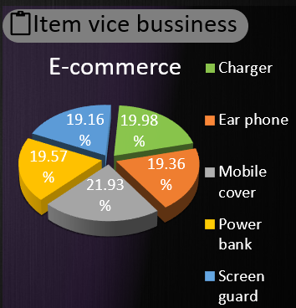
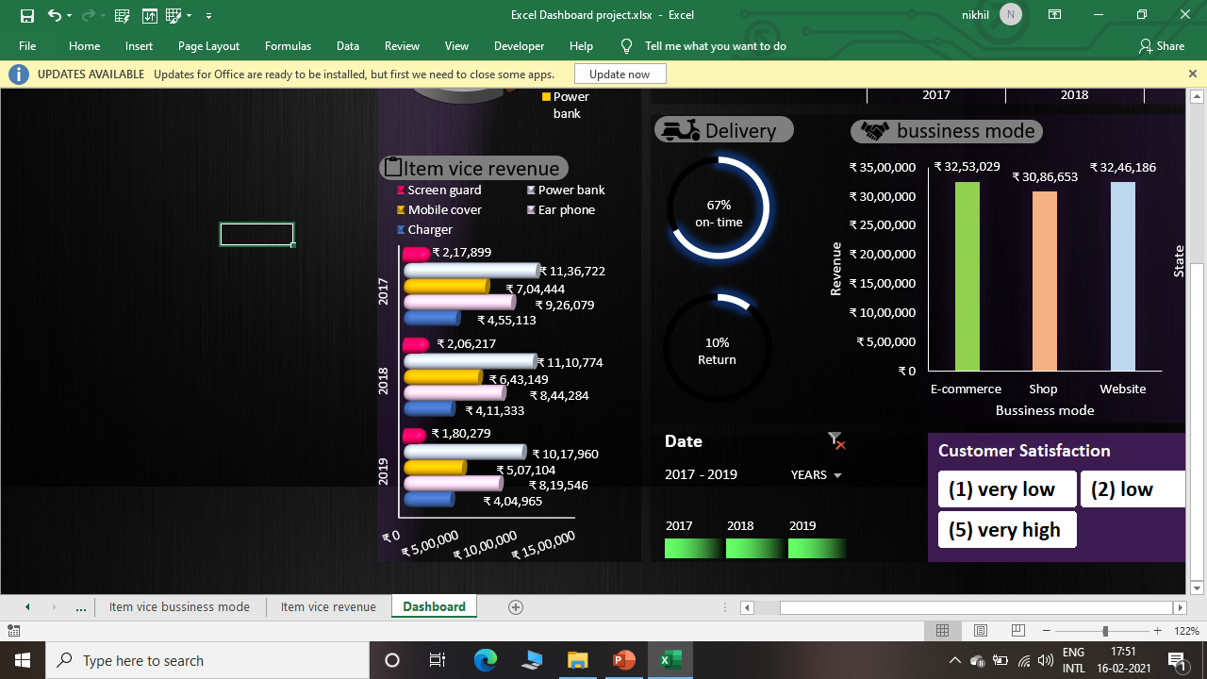
Funnel chart for state vice revenue and pie and column chart for item vice analysis

Slide 8
Conclusion
From the analysis of business I am concluding following points :
After analysing the data it is observe that the business started well in 2017 but by the time lots of fluctuations happened with business.
Most of the costumers are “ok” with the products.
Among the three modes business through E-commerce platform has more weightage in business.
Company should take more focus on delivery time.
Panjab and Bihar contributes major part in revenue.
Among the products power bank contributes more part in revenue.

Slide 9

THANK YOU!

